Slide 1
Networking in VirtualBox (VMM)
(Section 6 of VirtualBox User Manual 2020)

Slide 2
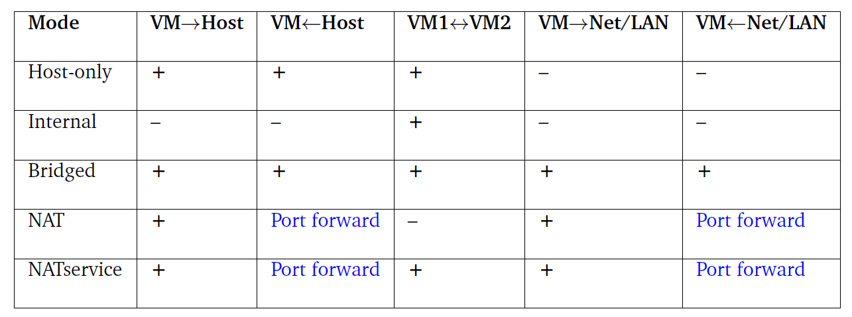
Networking in VirtualBox (Updated)
Various networking modes in VirtualBox:
Question: How do you choose a suitable networking mode for your need?
Source: “Oracle VirtualBox User Manual”, 2020

Slide 3
Networking in VirtualBox: Selection
Do you need a network of VMs?
Yes
No
NAT
Are the VMs part of the host’s network?
Can the VMs talk to your host?
Bridged
Internal
Can the VMs access the Internet?
Host-only
NAT Network

Slide 4
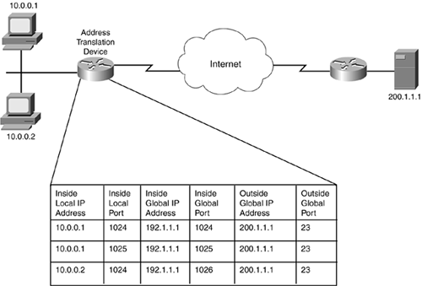
Network Address Translation Mode

Slide 5
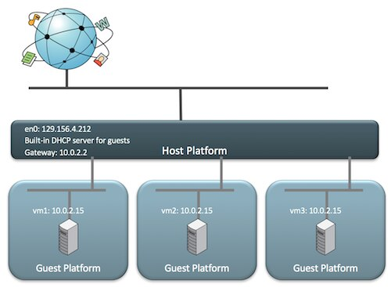
Network Address Translation Mode
See: https://blogs.oracle.com/scoter/networking-in-virtualbox-v2
NAT mode:

Slide 6
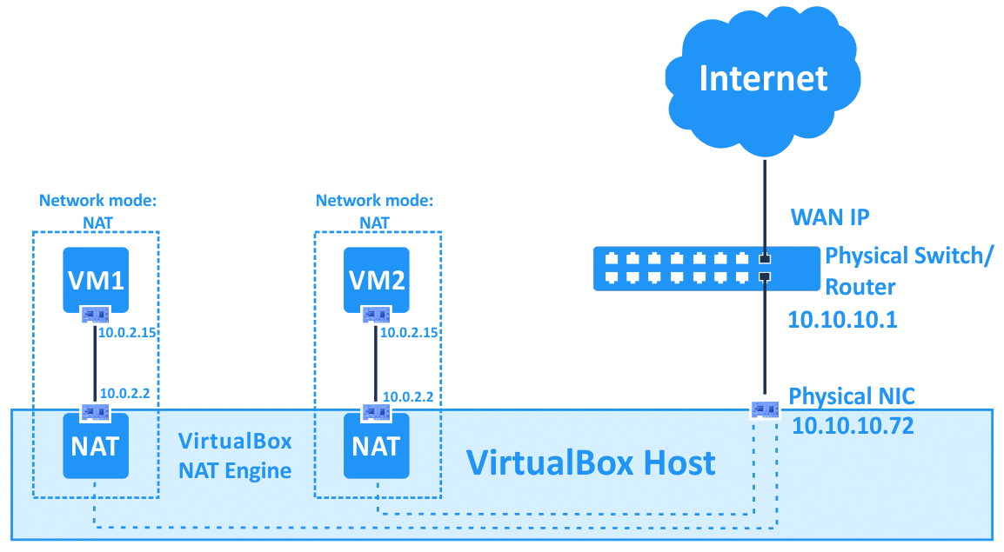
Network Address Translation Mode
See: https://www.nakivo.com/blog/virtualbox-network-setting-guide/
NAT mode:

Slide 7
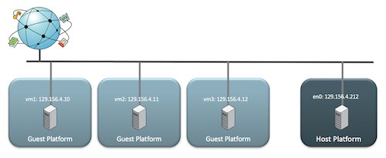
Bridged Mode
See: https://blogs.oracle.com/scoter/networking-in-virtualbox-v2
Bridged mode:

Slide 8
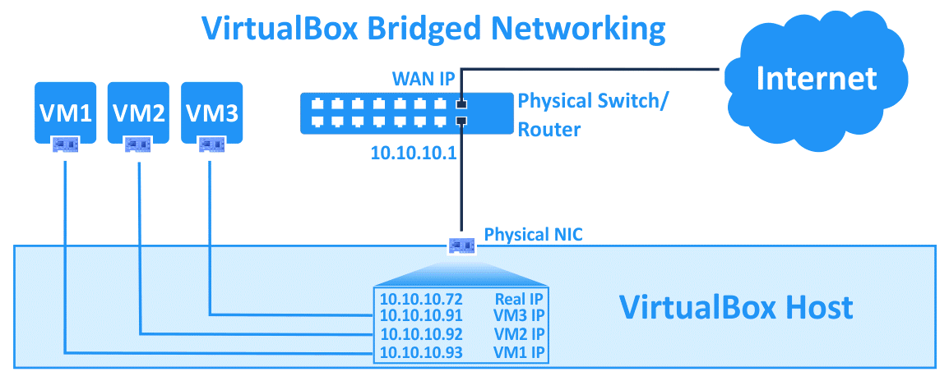
Bridged Mode
See: https://www.nakivo.com/blog/virtualbox-network-setting-guide/
Bridged mode:

Slide 9
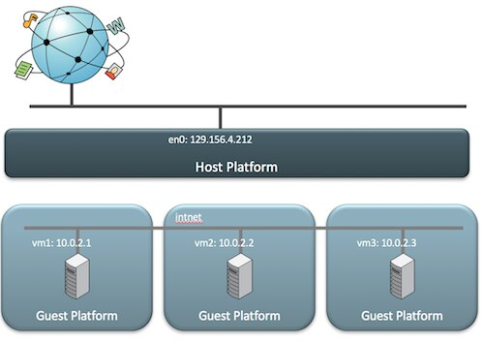
Internal Mode
See: https://blogs.oracle.com/scoter/networking-in-virtualbox-v2
Internal mode:

Slide 10
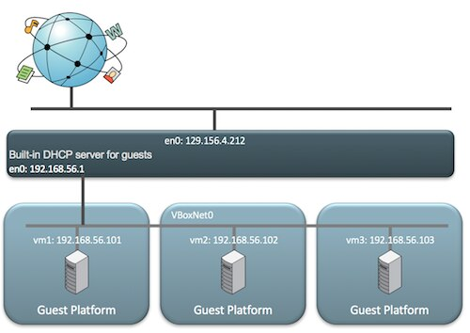
Host-Only Mode
See: https://blogs.oracle.com/scoter/networking-in-virtualbox-v2
Host-only mode:

Slide 11
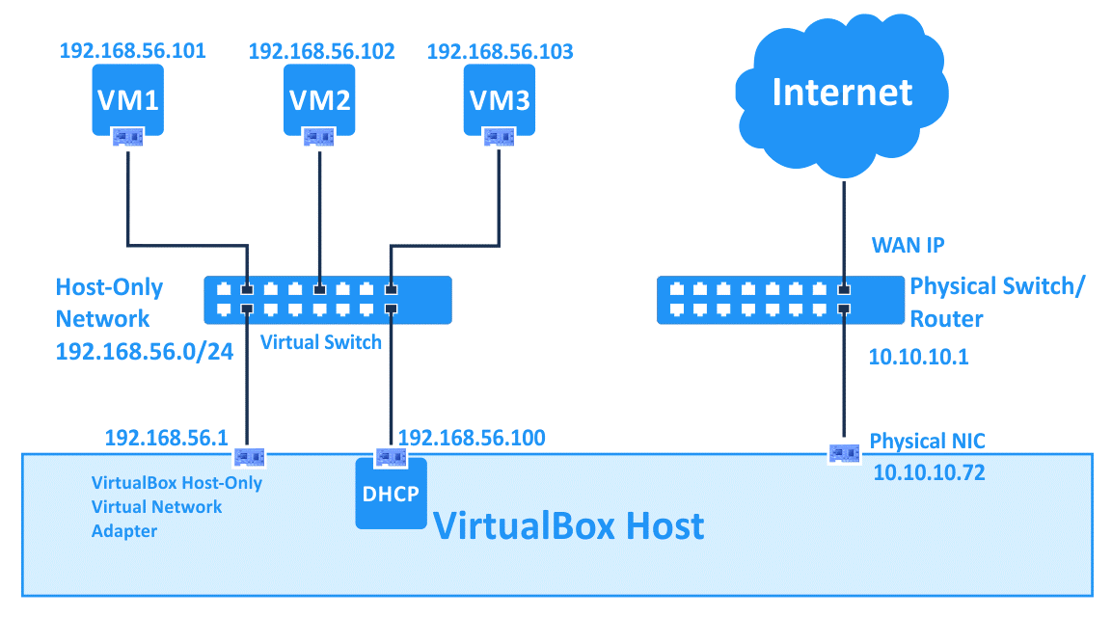
Host-Only Mode
See: https://www.nakivo.com/blog/virtualbox-network-setting-guide/
Host-only mode:

Slide 12
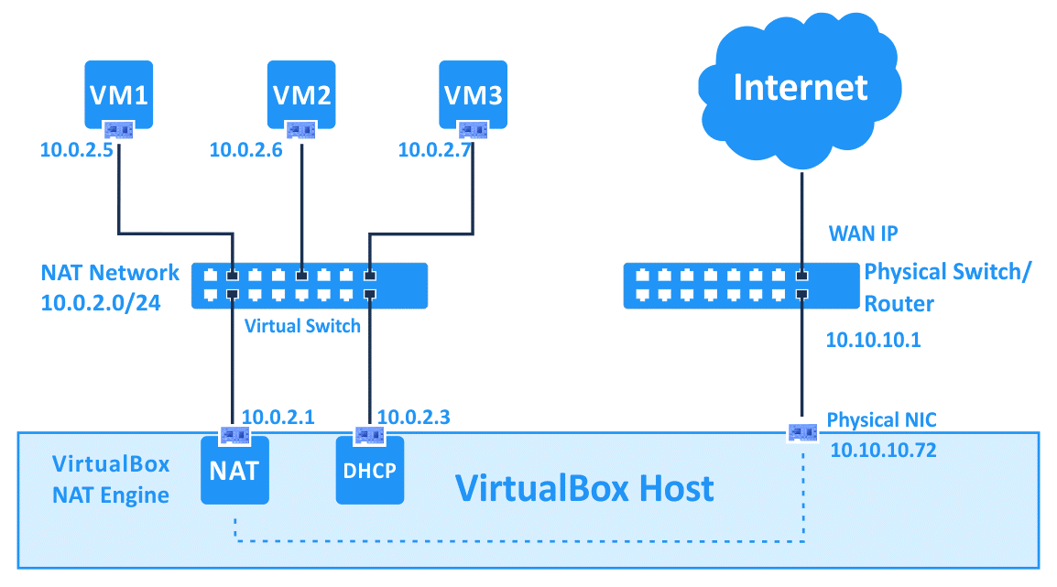
Host-Only vs. NAT Mode
See: https://www.nakivo.com/blog/virtualbox-network-setting-guide/
NAT network mode:

